Slide 1
Outline
Experiment results of PFC deadlock cases
Some analysis about PFC deadlock

Slide 2
Testbed information
Some testbed parameters:
Default TTL of RDMA packets: 16;
Switch forwarding-mode: store-and-forward;
Link capacity: 40Gbps;
Switch buffer size: 12MB;
Configured maximum frame size: 1024 bytes;

Slide 3
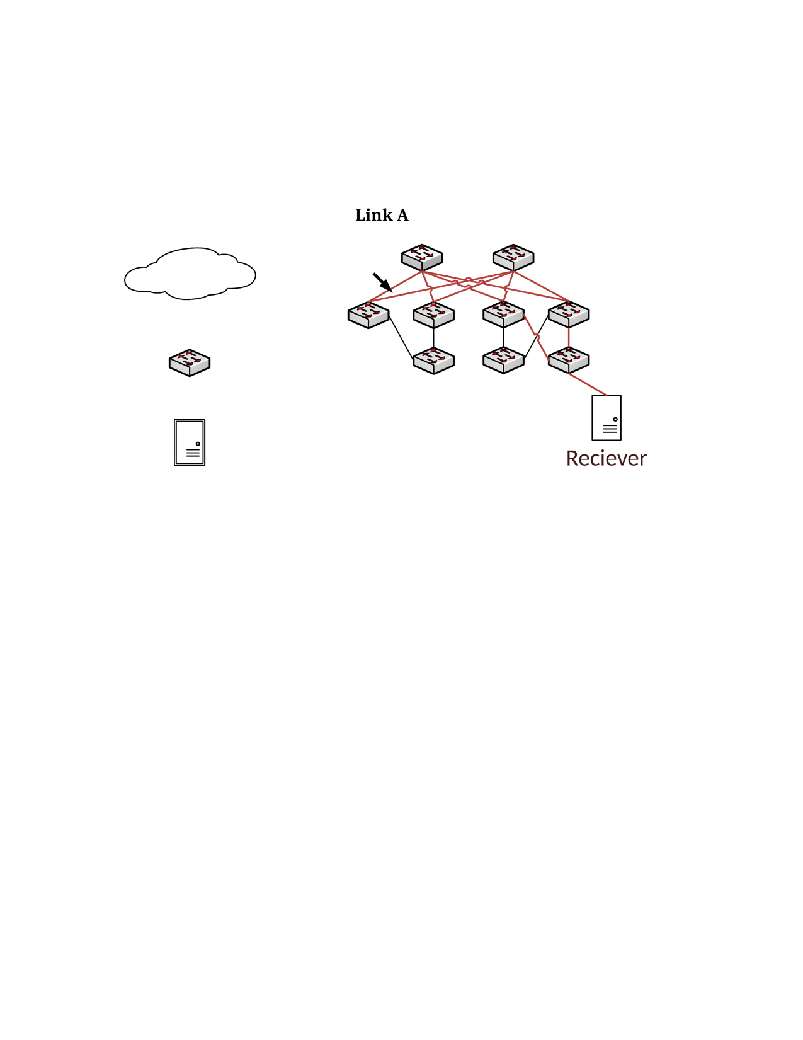
PFC deadlock experiment-A
S1
S2
L1
L3
L4
172.16.4.0/31 -> T4
1
2
40Gbps
30
30
172.16.4.5/32 -> L4
T1
T3
T4
H1: 172.16.3.6
H2: 172.16.4.5

Slide 4
PFC deadlock experiment-B
S1
S2
172.16.4.5/32 -> L3
L1
L3
L4
172.16.4.5/32 -> S1
1
2
40Gbps
30
30
172.16.4.5/32 -> L4
T1
T3
T4
H1: 172.16.3.6
H2: 172.16.4.5

Slide 5
More experiment results
Experiment results of 2-hop loop:
Message size(KB) | 2.2 | 2.5 | 5 | 10 | 60
Sending rate(Gbps) | 10 | 11.5 | 22 | 38 | 40
PFC deadlock | No | Yes | Yes | Yes | Yes
Experiment results of 4-hop loop:
Message size(KB) | 3.5 | 4100 | 4.5 | 10 | 60
Sending rate(Gbps) | 15 | 20 | 24.5 | 38 | 40
PFC deadlock | No | No | Yes | Yes | Yes

Slide 6
Takeaways of the two experiments
According to our analysis last week, TTL*one-hop-delay ≈ 16 * 0.2us = 8us should be a tight bound for PFC deadlock.
At rate 40Gbps, Only about 40KB packets can be injected into the loop within 8us, which is far smaller than the PFC threshold (measured threshold is about 2MB).

Slide 7
Takeaways of the two experiments
According to our analysis last week, TTL*one-hop-delay ≈ 16 * 0.2us = 8us should be a tight bound for PFC deadlock.
At rate 40Gbps, Only about 40KB packets can be injected into the loop within 8us, which is far smaller than the PFC threshold (measured threshold is about 2MB).
Two factors we need to consider when analyzing PFC deadlock:
Queuing delay in the routing loop.
PFC threshold is dynamic.

Slide 8

Impact of queuing delay on PFC deadlock
Time unit 0:
L4-1-rx
L4
queueing delay of the 1st pkt
Round | Time unit | Queueing delay | Remaining TTL
#1 | 0 | 0 | 15
L4-2-tx
L4-2-rx
$$\text{β}$$
T3
T4
T3-30-tx
T4-30-rx
T4-30-tx
*Let the time to send one 1KB pkt at rate 40Gbps to next hop as one time unit (~0.2us).

Slide 9
Impact of queuing delay on PFC deadlock
Time unit 1:
L4-1-rx
L4
queueing delay of the 1st pkt
Round | Time unit | Queueing delay | Remaining TTL
#1 | 0 | 0 | 15
L4-2-tx
L4-2-rx
$$\text{β}$$
T3
T4
T3-30-tx
T4-30-rx
T4-30-tx
*Let the time to send one 1KB pkt at rate 40Gbps to next hop as one time unit (~0.2us).

Slide 10
Impact of queuing delay on PFC deadlock
Time unit 2:
L4-1-rx
L4
queueing delay of the 1st pkt
Round | Time unit | Queueing delay | Remaining TTL
#1 | 0 | 0 | 15
#2 | 2 | 1 | 13
L4-2-tx
L4-2-rx
$$\text{β}$$
T3
T4
T3-30-tx
T4-30-rx
T4-30-tx
*Let the time to send one 1KB pkt at rate 40Gbps to next hop as one time unit (~0.2us).

Slide 11
Impact of queuing delay on PFC deadlock
Time unit 191:
L4-1-rx
L4
queueing delay of the 1st pkt
Round | Time unit | Queueing delay | Remaining TTL
#1 | 0 | 0 | 15
#2 | 2 | 1 | 13
#3 | 5 | 4 | 11
#4 | 11 | 10 | 9
#5 | 23 | 22 | 7
#6 | 47 | 46 | 5
#7 | 95 | 94 | 3
#8 | 191 | 190 | 1
L4-2-tx
L4-2-rx
$$\text{β}$$
T3
T4
T3-30-tx
T4-30-rx
T4-30-tx
The first packet will expire at time unit 15 without queuing delay.
*Let the time to send one 1KB pkt at rate 40Gbps to next hop as one time unit (~0.2us).

Slide 12
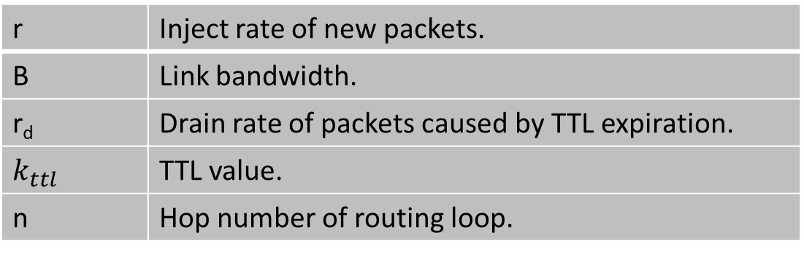
Analysis of the steady-state
r | Inject rate of new packets.
B | Link bandwidth.
r_{d} | Drain rate of packets caused by TTL expiration.
$$k_{ttl}$$ | TTL value.
n | Hop number of routing loop.
r
B - r_{d}
Two observations:
input rate = output rate;
The sum of TTLs of all pkts should be the fixed in a long-term view.
B

Slide 13
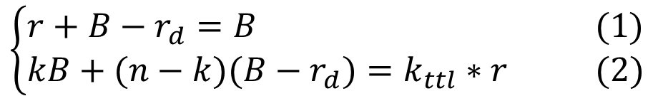
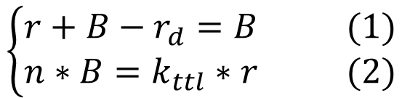
Analysis of the steady-state
Case 1: packets are dropped at the congestion hop (hop 1).
r
$$\left\{\begin{aligned}r+B−r_{d}=B (1) \\ n∗B=k_{ttl}∗r (2)\end{aligned}\right.$$
B - r_{d}
consuming rate of TTL
generating rate of TTL
Case 2: packets are dropped at some uncongested hop (hop k).
$$\left\{\begin{aligned}r+B−r_{d}=B (1) \\ kB+(n−k)(B−r_{d})=k_{ttl}∗r (2)\end{aligned}\right.$$
B
consuming rate of TTL
generating rate of TTL

Slide 14
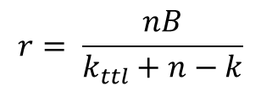
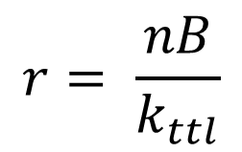
Analysis of the steady-state
Case 1: packets are dropped at the congestion hop (hop 1).
r
B - r_{d}
$$r= \frac{nB}{k_{ttl}}$$
Case 2: packets are dropped at some uncongested hop (hop k).
B
$$r= \frac{nB}{k_{ttl}+n−k}$$

Slide 15
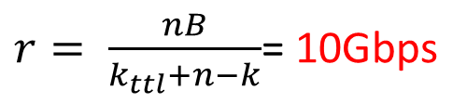
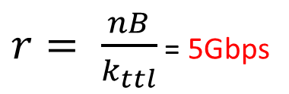
There is a difference between analysis and experiment results
Experiment results of 2-hop loop:
Message size(KB) | 2.2 | 2.5 | 5 | 10 | 60
Sending rate(Gbps) | 10 | 11.5 | 22 | 38 | 40
PFC deadlock | No | Yes | Yes | Yes | Yes
$r= \frac{nB}{k_{ttl}}$ = 5Gbps
Experiment results of 4-hop loop:
Message size(KB) | 3.5 | 4.1 | 4.5 | 10 | 60
Sending rate(Gbps) | 15 | 20 | 24.5 | 38 | 40
PFC deadlock | No | No | Yes | Yes | Yes
$r= \frac{nB}{k_{ttl}+n−k}$= 10Gbps
Possible reasons:
The arrival intervals between pkts is not the same (microburst).
PFC pause messages can reduce the queuing delay.

Slide 16
PFC threshold is dynamic
S1
S2
L1
L3
L4
172.16.4.0/31 -> T4
1
2
40Gbps
30
30
172.16.4.5/32 -> L4
T1
T3
T4
H1: 172.16.3.6
H2: 172.16.4.5

Slide 17
PFC threshold is dynamic
L4-1-rx
L4
L4-2-tx
L4-2-rx
Switch | PFC threshold + headroom
T3 | 2 MB
T4 | 2 MB
L4 | 3.5 MB/2 = ~ 1.75 MB
3.5MB
$$\text{β}$$
2MB
T3
T4
2MB
T3-30-tx
T4-30-rx
T4-30-tx

Slide 18
PFC threshold is dynamic
S1
S2
L1
L3
29
L4
172.16.3.6/32 -> S1
1
2
40Gbps
30
30
172.16.4.5/32 -> L4
T1
T3
T4
H1: 172.16.1.2
H2: 172.16.3.6
H3: 172.16.4.5

Slide 19
PFC threshold is dynamic
2.1MB
L4-1-rx
L4
L4-29-rx
some buffer is occupied.
L4-2-tx
L4-2-rx
2.8MB
Switch | PFC threshold + headroom
T3 | 2 MB
T4 | 2 MB
L4 | 2.8MB/2 = 1.4 MB
$$\text{β}$$
2MB
T3
T4
2MB
T3-30-tx
T4-30-rx
T4-30-tx

